Slide 1
Consumer Goods Ad-hoc Analysis
Resume Project Challenge #4

Slide 2
Problem Statement
Atliq Hardwares is one of the leading computer hardware producers in India and well expanded in other countries too.
However, the management noticed that they do not get enough insights to make quick and smart data-informed decisions.
There are 10 ad-hoc requests which the company needs insights .
Objective is to run a SQL query to answer the requests and covert it into the visualizations and present Insights to the top level management.

Slide 3
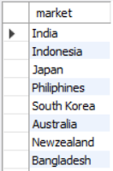
Request #1
Provide the list of markets in which customer "Atliq Exclusive" operates its business in the APAC region.

Slide 4
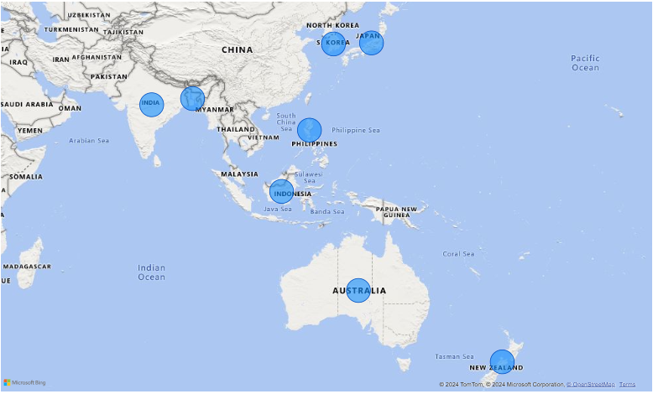
Insights
There are total 8 markets in APAC region where “Atliq Exclusive” operates its business.

Slide 5

Request #2
What is the percentage of unique product increase in 2021 vs. 2020? The final output contains these fields:
unique_products_2020 unique_products_2021 percentage_chg

Slide 6
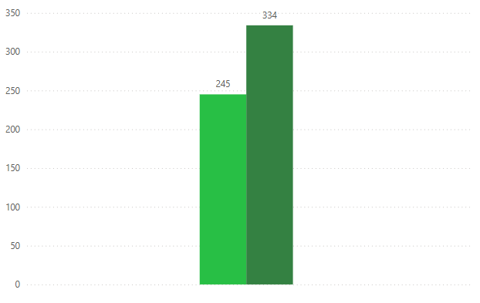
Insights
In FY 2020, we had a total of 245 unique products, but in FY 2021, our count increased by 36.33% to 334 unique products. This show that we are constantly trying to innovate to bring new products in the market.

Slide 7
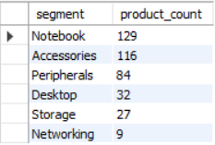
Request #3
Provide a report with all the unique product counts for each segment and sort them in descending order of product counts. The final output contains 2 fields:
segment
product_count

Slide 8
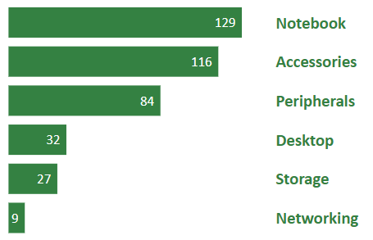
Insights
Segments: notebooks, accessories, and peripherals are showing significant manufacturing growth as compared to desktops, storage, and networking. Notebooks, accessories, and peripherals constitute 83% of the total manufactured product.

Slide 9
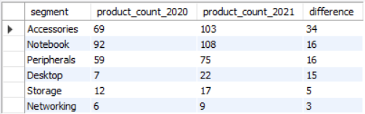
Request #4
Follow-up: Which segment had the most increase in unique products in 2021 vs 2020? The final output contains these fields:
segment
product_count_2020 product_count_2021
difference

Slide 10
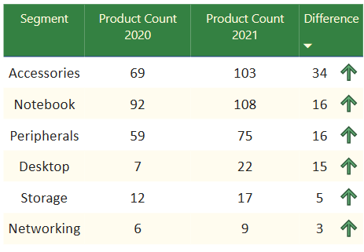
Insights
There has been increase in unique products in year 2021 as compared to 2020 in all the segments. Accessories had the largest increase in production. Storage and networking are experiencing slower production growth than other segments.

Slide 11

Request #5
Get the products that have the highest and lowest manufacturing costs. The final output should contain these fields:
product_code
product
manufacturing_cost

Slide 12


Insights
AQ Master wired x1 Ms ( Mouse) has the lowest manufacturing cost.
AQ Home Allin1 Gen2 (Desktop) has the highest manufacturing cost.
$263.43
$0.87

Slide 13
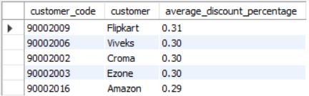
Request #6
Generate a report which contains the top 5 customers who received an average high pre_invoice_discount_pct for the fiscal year 2021 and in the Indian market. The final output contains these fields:
customer_code
customer
average_discount_percentage

Slide 14
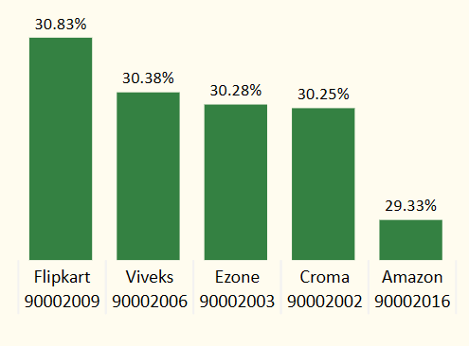
Insights
Flipkart received the largest average pre invoice discount in fiscal year 2021 in Indian market, While Amazon got the least in the same year.

Slide 15
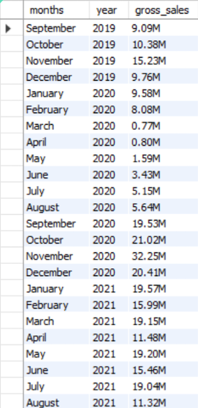
Request #7
Get the complete report of the Gross sales amount for the customer “Atliq Exclusive” for each month . This analysis helps to get an idea of low and high-performing months and take strategic decisions. The final report contains these columns:
Month
Year
Gross sales
Amount

Slide 16
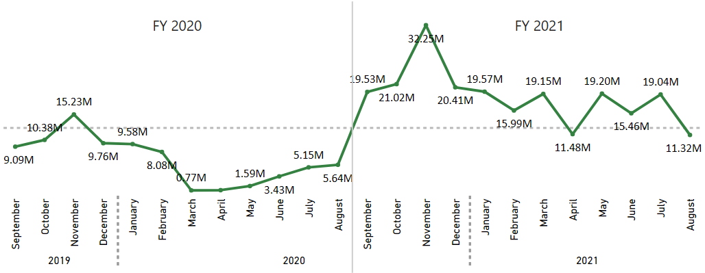
Insights
For AtliqExclusive, November 2020 marked the highest sales, and March 2020 marked the lowest gross sales.
The lower sales between March and August are because of COVID-19.
However, it’s a very good sign that the sales increased quickly after August and reached the highest level since the last two years in November.

Slide 17
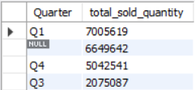
Request #8
In which quarter of 2020, got the maximum total_sold_quantity? The final output contains these fields sorted by the total_sold_quantity,
Quarter
total_sold_quantity

Slide 18
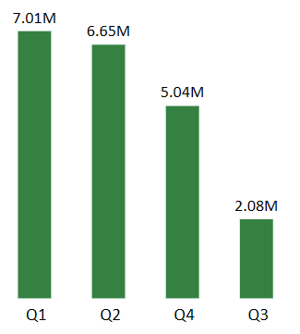
Insights
The sold quantity decreased to 2.08 million in quarter 3 of FY 2020, which was actually March, April, and May when COVID-19 was at its peak.
But we started recovering early during quarter 4 is probably because of the increased need for hardware like desktops and notebooks as majority of the students began or continued to do their coursework online during this time, and there was a huge demand for computer accessories during this period.

Slide 19

Request #9
Which channel helped to bring more gross sales in the fiscal year 2021 and the percentage of contribution? The final output contains these fields:
channel
gross_sales_mln
percentage

Slide 20
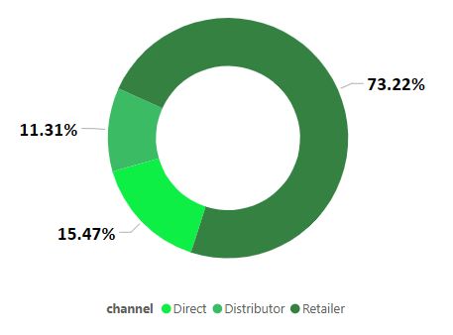
Insights
In FY 2021, majority of our sales took place via retailers, which is 75% of the total sales. Only a very small percentage of our sales happened through direct and distributor channels.

Slide 21
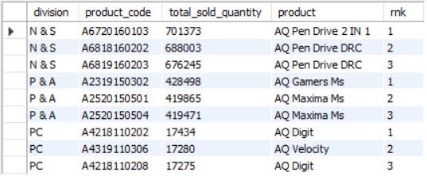
Request #10
Get the Top 3 products in each division that have a high total_sold_quantity in the fiscal_year 2021? The final output contains these fields:
division
product_code
product
total_sold_quantity
rank_order

Slide 22
Insights
The top 3 selling products in N&S were pen drives, which were around 7 lakh in quantity.
The top 3 selling products in P&A were mouse, which were around 4 lakh in quantity.
The top 3 selling products in PC were personal laptops, which were around 17000 in quantity.

Slide 23
Thank You

